Slide 1
Maritime Data Intelligence System - Predicting the revenue of Ship Chartering Business
By Rucha Joshi

Slide 2
Agenda
Problem Overview
Data Set Overview
Data Wrangling
Exploratory Data Analysis
Model Selection and Results
Conclusion
Recommendations

Slide 3
Problem Overview

Slide 4
Shipping has been key in facilitating trade and globalization. It is one of the largest industry in the world.
This sector handles roughly 60% of the value and 75% of the tonnage of world trade according to Lloyd’s MIU.
Shipping industry is very competitive, in addition to competing with each other, they must fight with all four modes of freight transportation: air, rail, water and road. Recently these conscious shippers are getting more aware of all the costs by analyzing their history data to make more precise decisions.
Prediction of the revenue on the particular charter by creating a machine learning model based on the previous year’s available data will help the shipper to choose best trades to get the maximum profit.
Our goal in this project is to help shipowners to choose the charter wisely to maximize their profits by identifying the cost affecting factors on the voyage.
We built the model that can explain which factors have predictive power.

Slide 5
Data Set Overview

Slide 6
The dataset includes about 185,000 observations which has voyages from 2009 across the world. The other datasets are Port details, Vessel details and Voyage details.
The data includes following important fields -
Voyage Id - Id assigned to each voyage
Vessel Id - Id assigned to each vessel
Commencing Date - Start date for the voyage
Completing Date - End date for the voyage
Vessel types - There are total 12 different types of vessels.
Vessel description - Is vessel a Tanker or a Bulk
Cargo types- There are 20 unique values of cargo types.
First load port - This is the port where first vessel got loaded.
Last discharge port - This is the last discharge port for the voyage. There can be multiple discharge ports for single voyage.

Slide 7
Cargo lift - It tells us how much cargo the vessel is carrying.
Dwt - Deadweight tonnage of the ship.
Estimated earnings and Actual Earnings
Trade Area - The area where the voyage is travelling.
Estimated voyage days and Actual voyage days
Ballast days - when vessel is empty
Laden days - when vessel is loaded
Base Currency - Currency of earnings
Operators details
Laden and Ballast Speed - this is finalized at the charter party.
Vessel properties such as built year, owner etc.
And there are few more fields for internal use of the shippers which are not relevant to our analysis.

Slide 8
Data Wrangling
Data cleaning and reformatting

Slide 9
Data Loading
Missing Value Replacement
Handling Outliers
Reformatting

Slide 10
Exploratory Data Analysis
Which variables appear to have predictive power?

Slide 11
Top Trade Areas
These are the top trade areas with respect to sum of earnings.

Slide 12
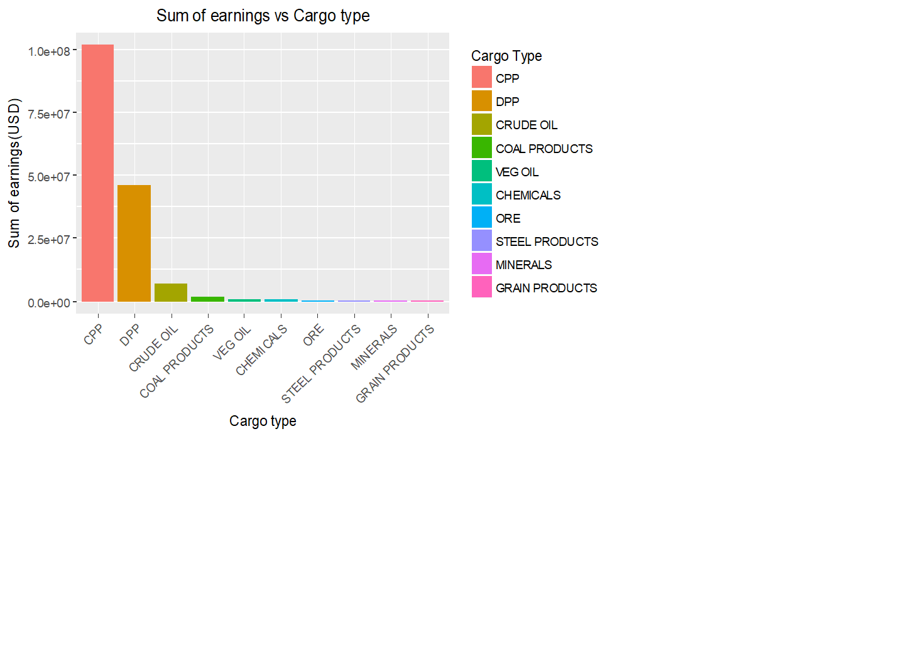
Top Cargo types
This graph shows that CPP, DPP and Crude Oil are major contributors in the high earnings.

Slide 13
Model Selection and Results

Slide 14
Model Workflow
Tuning Model Parameters
Data Wrangling
Data Partition
Training Data
Build Model
Training Results
Data
Test Data
Trained Model
Test Results

Slide 15
Linear Regression
As the data is supervised data we first tried to fit Linear Regression model to predict the earnings of a voyage.
We used forward selection approach in building the linear regression model, which starts with no predictors in the model, iteratively adds the most contributive predictors, and stops when the improvement is no longer statistically significant

Slide 16
After the third iteration of the model we get the list of variables which are statistically significant with the
Multiple R-squared: 0.5005
Adjusted R-squared: 0.4966
p-value: < 2.2e -16

Slide 17
Random Forest Algorithm
After checking the results of Linear regression, we decided to use Random Forest Technique to see improvements in the results; as it is ensemble learning technique where data is trained on multiple models then output rule is combined to get Stronger model which performs well and balances Bias-Variance tradeoff.

Slide 18
After removing outliers in 5th iteration of the model we get the list of variables which are statistically significant with the
R-squared: 0.5251
% var explained: 52.71
The results are improved than our previous results.

Slide 19
Conclusion

Slide 20
Our Random Forest model shows improved results over Linear Regression model.
From our models we can say that Earnings can be predicted using vessel type, loading and discharge ports, cargo type, deadweight tonnage, cargo lift etc. independent variables.
While we have been able to improve the results, this may not be enough for the predictions as Weather related information is not provided.
If the information about intermittent stops for loading and discharge for a voyage is provided then it will be helpful to get more accurate predictions.

Slide 21
Recommendations

Slide 22
Including weather data for each voyage for further analysis will be helpful to get more precise predictions as it is directly related to fuel consumptions.
Information about intermittent stops for loading and discharging will help in building more accurate model.
To improve the accuracy in the prediction we can try using different algorithms like Extreme gradient boosting.
Comparison of competitor's business can provide more ideas to improve the business.

